Slide 1

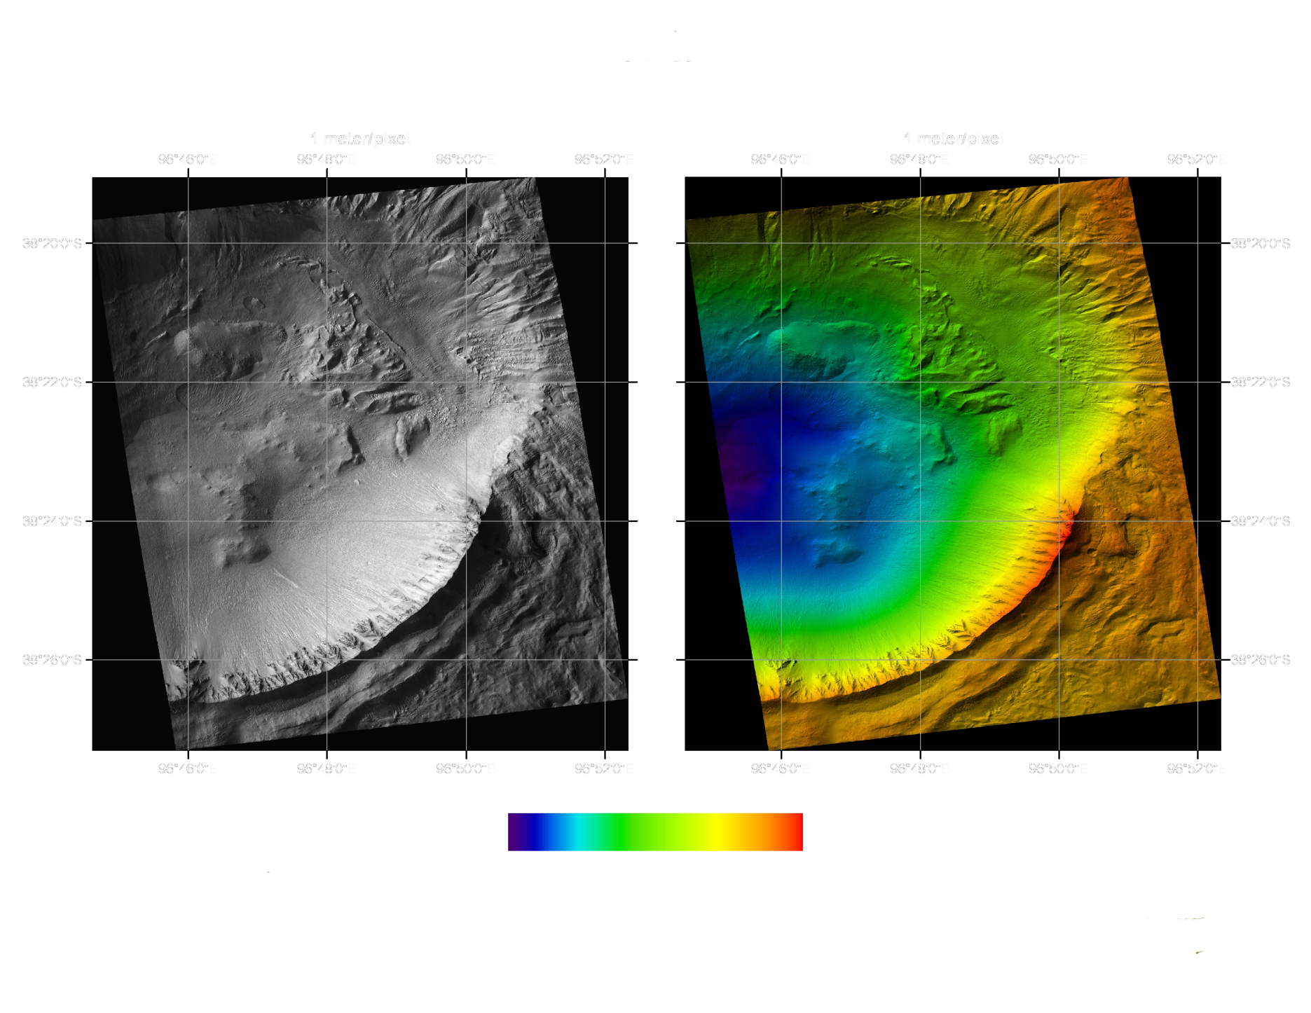
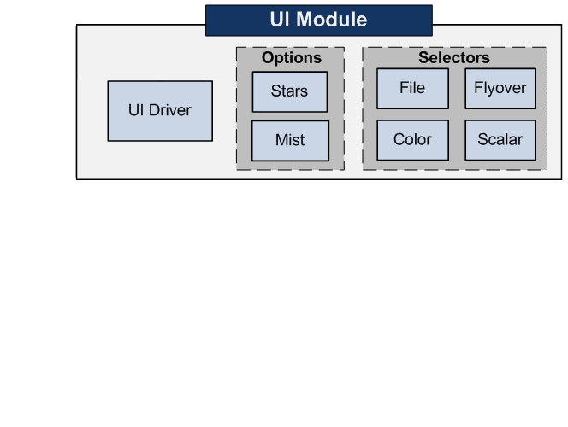
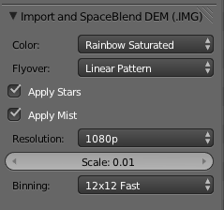
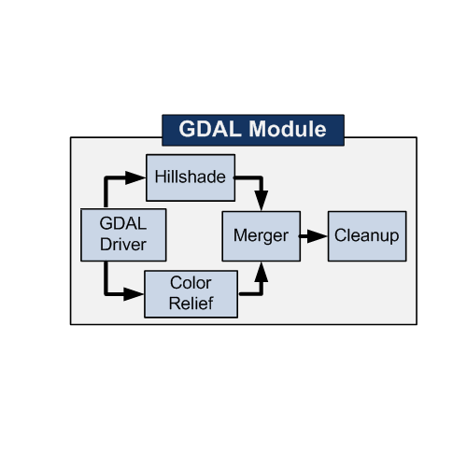
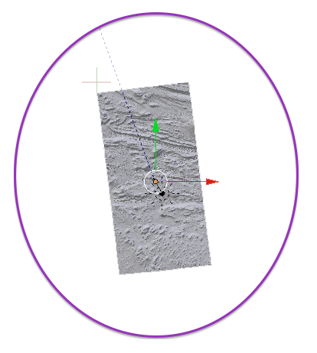
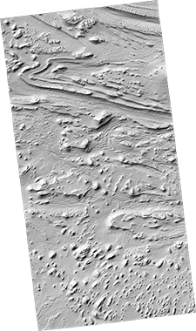
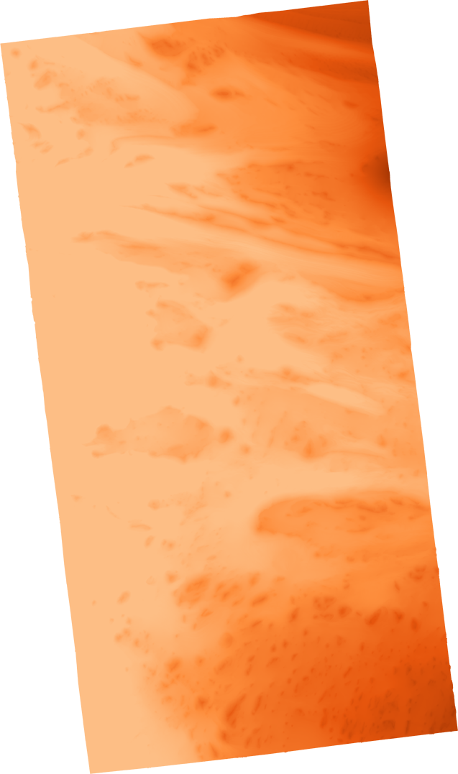
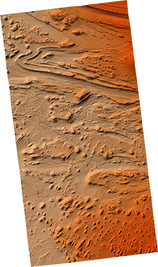
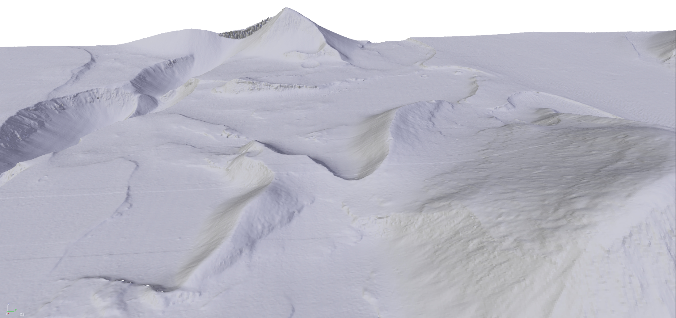
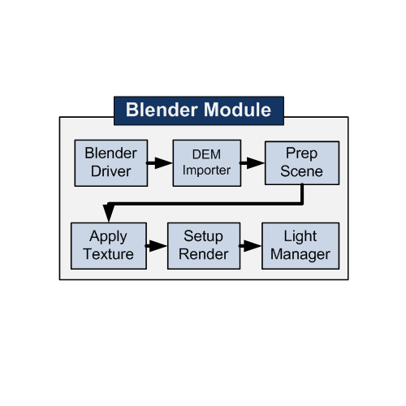
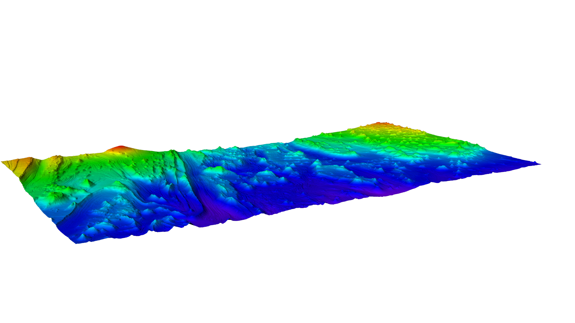
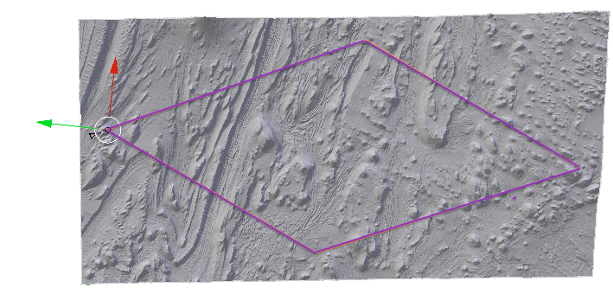
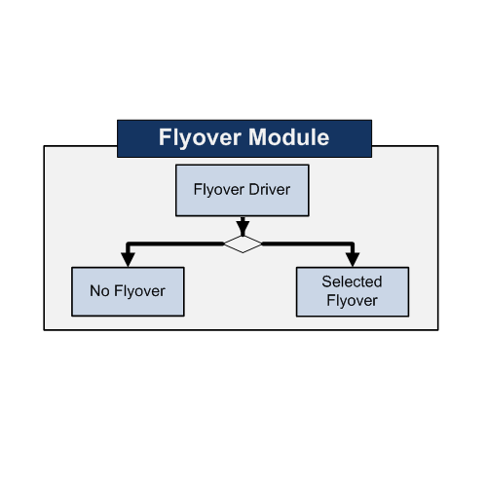

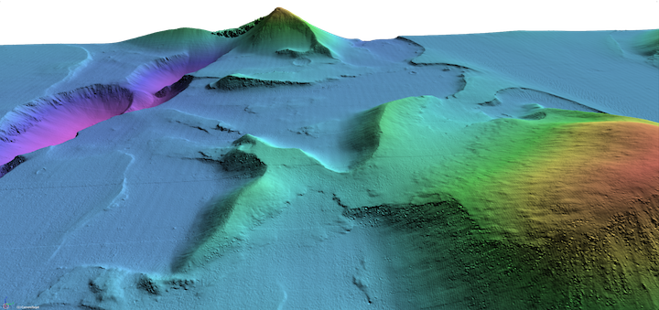
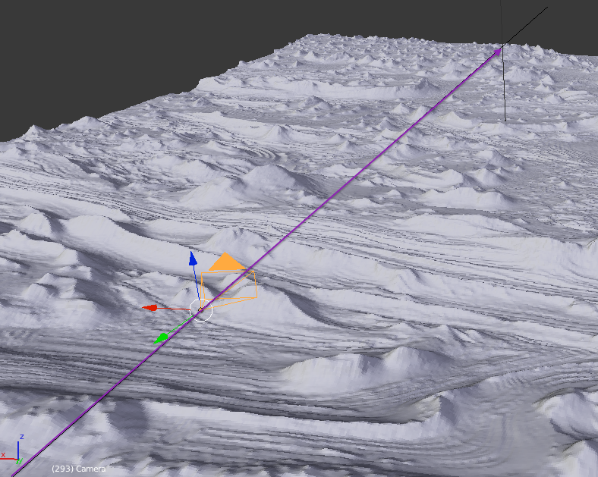

3D Pipeline of Planetary Surfaces
Andrew Carter, Eric Ghazal, Jason Hedlund, Terence Luther
Department of Computer Science, Northern Arizona University; USGS, Flagstaff, AZ
Problem
Solution and Product
Flyover and Videos
USGS needs a tool for their scientists to be able to visualize and study planetary surfaces in 3D
In order to be able to fully visualize the landscape of an image, we have automated our application to provide several patterns for a camera to fly over a landscape and export to video.
Example Flyover Patterns:
Circular
Diamond
Low
High
Current tools used can only provide 2-Dimensional images to work off of. This makes it difficult to fully realize the actual landscape.
GDAL Hill Shade GDAL Color Relief Merged Texture
In 3-Dimensions, features of the landscape are much easier to distinguish.
Current process of making 3D images is a multi-step, time consuming, and complicated process.
Because of these issues our job was to:
Automate current tools to create 3D images
Provide visual effects for a 3-D environment
Create videos that display the landscape in 3D
Package all the tools into one application
Deployment
Deployment of our Blender Plug-in?
The USGS will include our plug-in as part of their image processing software package
The plug-in will be submitted as an official plug-in to be included in the Blender application
The plug-in is Open Source and available for other developers to modify or add features
Low
High
Linear flyover pattern
Acknowledgments
Our sponsor – Trent Hare, USGS
Our mentor – Dr. James Palmer
UAHiRise – Tim Spriggs

